Slide 1


Slide 2
Interaction Design & Prototyping in HCI

Slide 3
1. Interaction Design
Focuses on how users interact with a system.
Goals:
Make interfaces intuitive and user-friendly.
Support users’ tasks and goals.
Key Elements:
Consistency – Similar actions should behave similarly.
Feedback – Users should know what’s happening (e.g., loading spinner).
Affordances – Visual clues showing how to interact (e.g., buttons).

Slide 4
2. The Process of Interaction Design
Understanding Users – Research target users, their tasks, and goals.
Design Requirements – Define what the system should do.
Design Solutions – Sketch ideas and layouts.
Prototyping – Create interactive models.
Evaluation & Iteration – Test with users and improve.

Slide 5
3. Paper Prototyping & Digital Wireframing
Paper Prototyping
Quick sketches on paper.
Low-cost, fast iteration.
Good for early-stage ideas.
Digital Wireframing
Tools: Figma, Adobe XD.
Create interactive mockups.
Easier to share and test digitally.

Slide 6
4. Low-Fidelity vs. High-Fidelity Prototypes
Low-Fidelity: Simple sketches, minimal interactivity, test concepts, Paper
High-Fidelity: Realistic design, fully interactive, test detailed UI/UX, Figma/Adobe XD
Feature | Low-Fidelity (Lo-Fi) | High-Fidelity (Hi-Fi)
Appearance | Simple sketches | Realistic design
Interactivity | Minimal | Fully interactive
Purpose | Test concepts | Test detailed UI/UX
Tools | Paper, Balsamiq | Figma, Adobe XD

Slide 7
5. Case Study: Improving UI of an Existing App
Example: Redesigning a to-do list app.
Steps:
Observe user pain points (e.g., mixed-up layout).
Create Lo-Fi sketches of simpler layout.
Build Hi-Fi prototype in Figma.
Test with users and iterate.
Result: Users complete tasks faster and with less confusion.

Slide 8
EXAMPLE
Case Study: Improving UI of a Weather App
Example: Redesigning a simple weather app.
Steps:
Observe user pain points – Users find the app confusing because the temperature, forecast, and icons are all cluttered.
Create Lo-Fi sketches – Draw a simple layout showing the temperature at the top, forecast below, and large clear icons.
Build Hi-Fi prototype – Use Figma to make an interactive version where users can tap icons to see hourly forecast.
Test & iterate – Users test the prototype, give feedback, and changes are made to make it even clearer.
Result: Users can check the weather quickly without confusion.

Slide 9
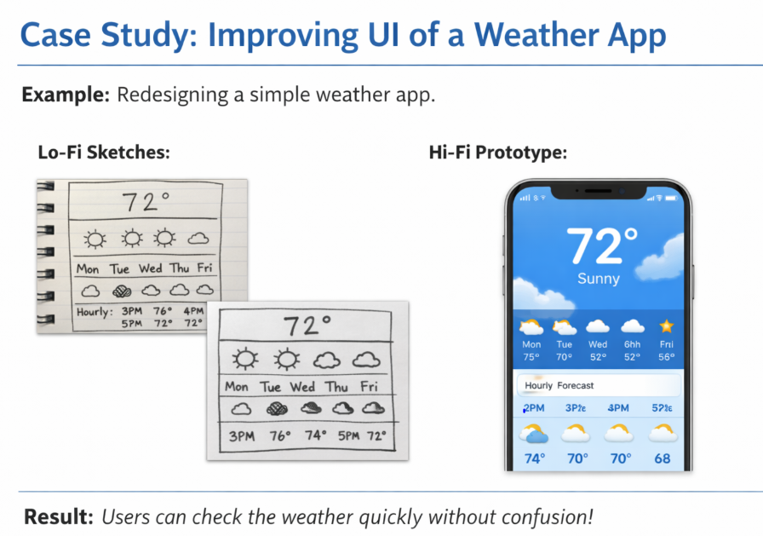

Slide 10
